Slide 1
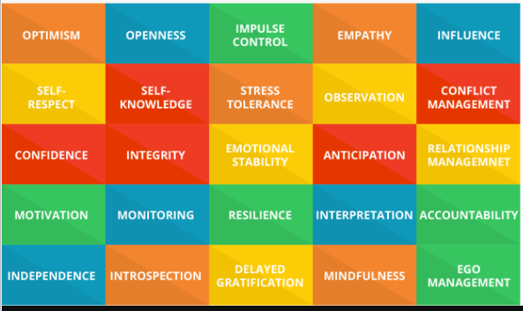
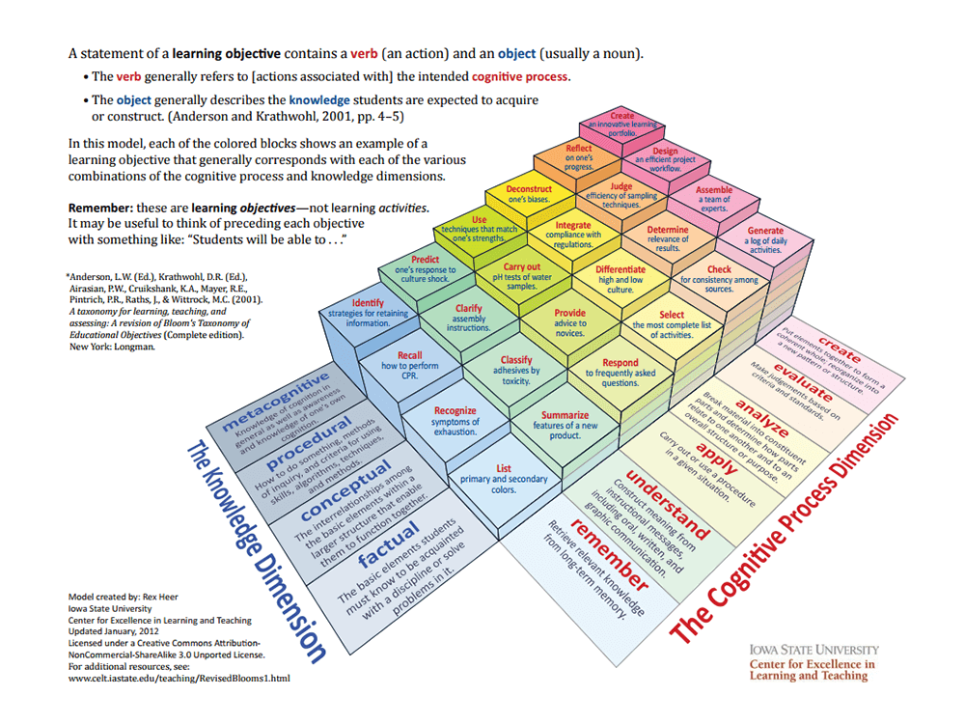

Responsibility
Strategic Thinking
Performance Design
Designing systems
Social World.
Social design

